Slide 1
Why Did You Choose CSE?

Slide 2
Introduce With Structural Programming Language And Other Related Terms
Course Title :- Structured Programming Language Sessional
Course Code :- CSE-122
Level Term: 1-II-A(G1) & 1-II-B(G3,G4)
Khandaker Jannatul Ritu, Lecturer(CSE), BAIUST

Slide 3
Content Of This Lecture

Slide 4
Resources will be followed:
Books:
C: the complete reference
Programming in ANSI-C
C programming by tamim shahriar subin
52 Programming Problem Tamim Shahriar Subeen
Websites:
https://www.w3schools.com/c/index.php
https://www.programiz.com/c-programming
https://www.javatpoint.com/c-programming-language-tutorial
https://www.geeksforgeeks.org/c-programming-language/
https://www.tutorialspoint.com/cprogramming/index.htm
YouTube Tutorials to follow(click on the link):-
C Programming Bangla Tutorials (সবার জন্য সি প্রোগ্রামিং) | Updated in 2023 - YouTube
Khandaker Jannatul Ritu, Lecturer(CSE), BAIUST

Slide 5
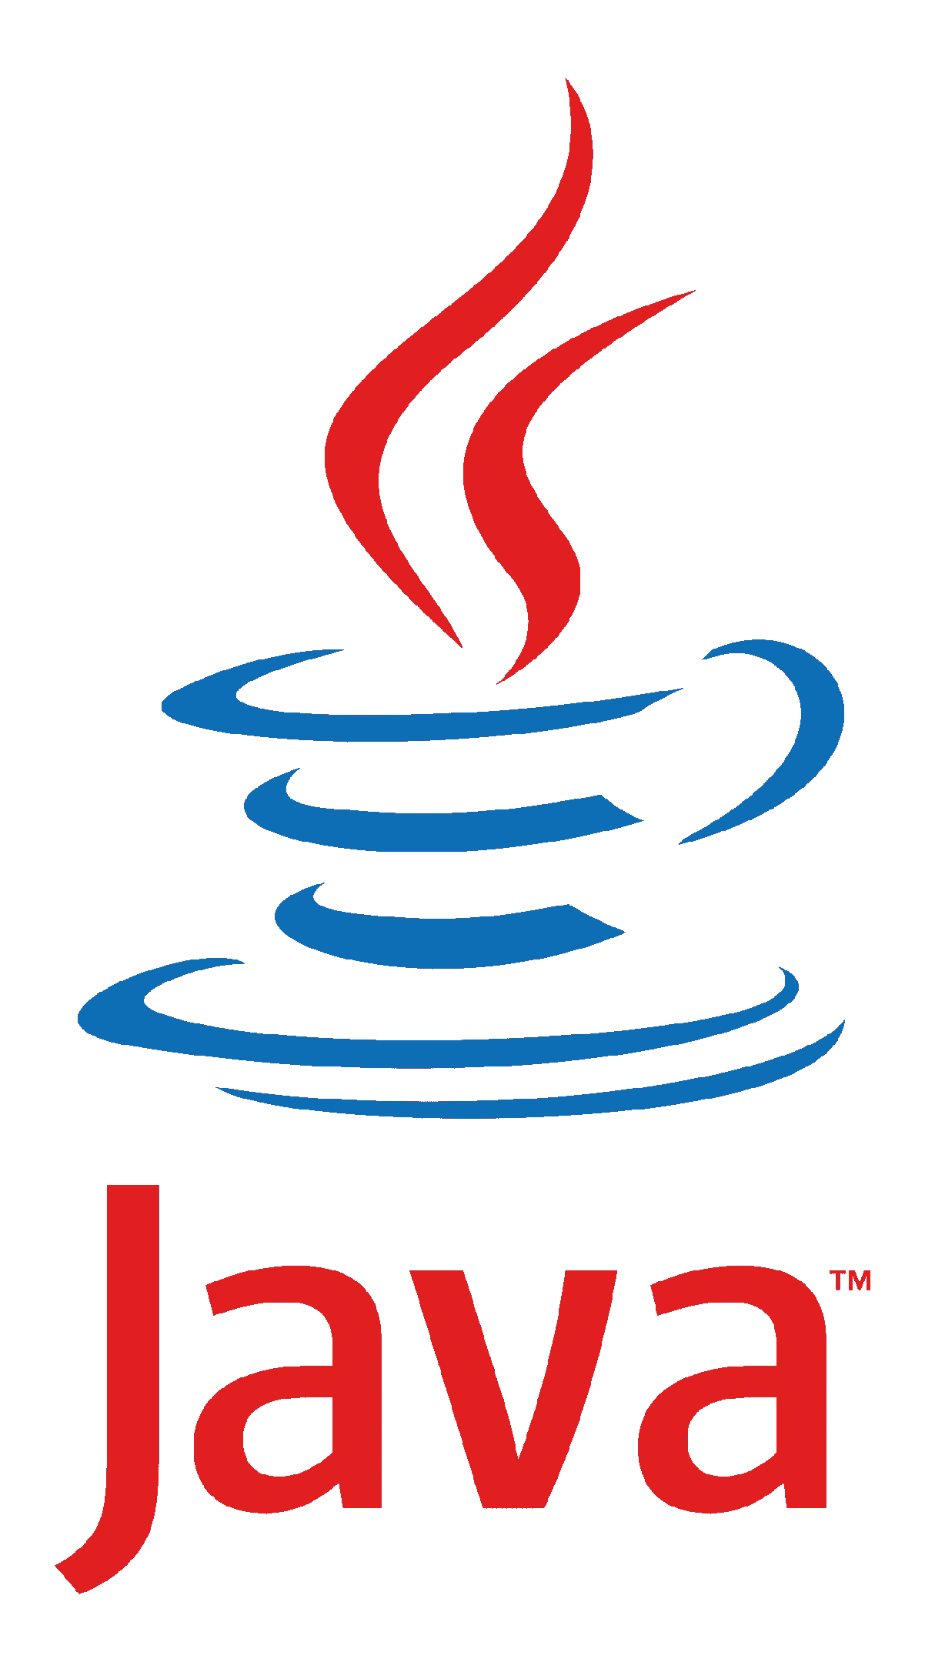









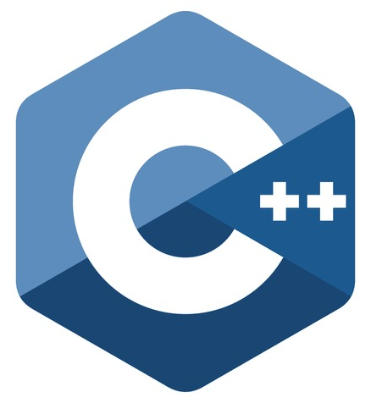
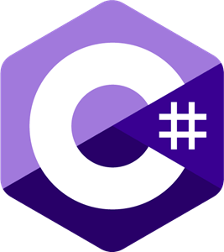
Popular Programming languages
1. Javascript 2. Python 3. Go 4. Java 5. Kotlin 6. PHP 7. C# 8. Swift 9. R 10. Ruby 11. C and C++
Khandaker Jannatul Ritu, Lecturer(CSE), BAIUST

Slide 6













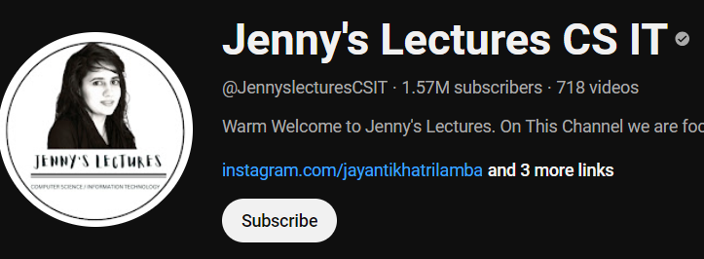




Necessary Websites & Tools Related To Programming

Slide 7











Competitive Programming OJ

Slide 8











Necessary Websites & Tools Related To Programming

Slide 9
C Programming Language
Khandaker Jannatul Ritu, Lecturer(CSE), BAIUST

Slide 10
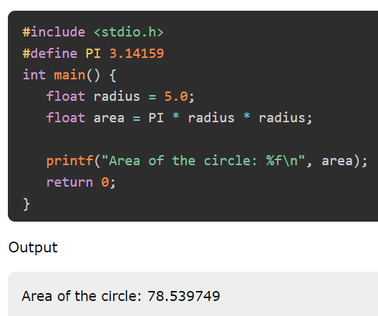
General Overview of a Simple C Program's Structure:
Header Files
Main Function
Variable Declarations
Statements and Expressions
Comments:
// for single-line comments
/* */ for multi-line comments.
Return Statement
Functions:
Standard Input/Output:
C has library functions for reading user input (scanf) and printing output to the console (printf).
#include <stdio.h>
int main()
{
int a = 10, b = 4, res;
res = a + b; // addition
printf("a + b is %d\n", res);
return 0;
}
Khandaker Jannatul Ritu, Lecturer(CSE), BAIUST

Slide 11
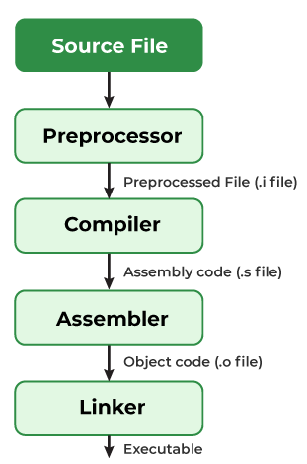
Compilation process in C
Khandaker Jannatul Ritu, Lecturer(CSE), BAIUST

Slide 12
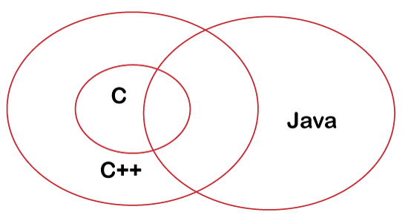
Differences Between C, C++ and Java
Khandaker Jannatul Ritu, Lecturer(CSE), BAIUST

Slide 13
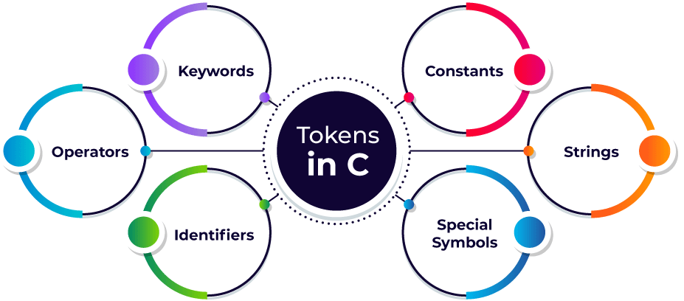
Tokens in C
A token in C can be defined as the smallest individual element of the C programming language that is meaningful to the compiler. It is the basic component of a C program.
A token in C is the meaningful smallest unit used in a C program.
Types of Tokens in C: The tokens of C language can be classified into six types based on the functions they are used to perform.
Khandaker Jannatul Ritu, Lecturer(CSE), BAIUST

Slide 14
Keywords in C
In C Programming language, there are many rules so to avoid different types of errors. One of such rule is not able to declare variable names with auto, long, etc. This is all because these are keywords. Let us check all keywords in C language.
What are Keywords?
Keywords are predefined or reserved words that have special meanings to the compiler. These are part of the syntax and cannot be used as identifiers in the program. A list of keywords in C or reserved words in the C programming language are mentioned below:
auto | break | case | char | const | continue | default | do
double | else | enum | extern | float | for | goto | if
int | long | register | return | short | signed | sizeof | static
struct | switch | typedef | union | unsigned | void | volatile | while
Khandaker Jannatul Ritu, Lecturer(CSE), BAIUST

Slide 15
C Identifiers
Identifiers are unique names that are assigned to variables, structs, functions, and other entities.
Rules to Name an Identifier in C
An identifier can include letters (a-z or A-Z), and digits (0-9).
An identifier cannot include special characters(/,<,>,*,!,~,#,@,$,%,^,&,*) except the ‘_’ underscore.
Spaces are not allowed while naming an identifier.
An identifier can only begin with an underscore or letters.
We cannot name identifiers the same as keywords because they are reserved words to perform a specific task. For example, printf, scanf, int, char, struct, etc.
The identifier must be unique in its namespace.
C language is case-sensitive so, ‘name’ and ‘NAME’ are different identifiers.
✅ Number, num=2, val, VAL=23, number1,number2, a1,a2,
❌ 1num, #val, ^list, $name, ~age, &age
✅ _num1, num1_, customer_list, customer_list1
❌ 1num_, customer-list, 1_num,
✅ customer_list
❌ customer list
✅ INT, PRINTF, CHAR
❌ int = 0, printf=0,
✅ name=0, NAME=0, Name=0, NaMe=0, NAMe=0,namE=0
Khandaker Jannatul Ritu, Lecturer(CSE), BAIUST

Slide 16
C Comments
The comments in C are human-readable explanations or notes in the source code of a C program. A comment makes the program easier to read and understand. These are the statements that are not executed by the compiler or an interpreter.
It is considered to be a good practice to document our code using comments.
When and Why to use Comments in C programming?
A person reading a large code will be bemused if comments are not provided about details of the program.
C Comments are a way to make a code more readable by providing more descriptions.
C Comments can include a description of an algorithm to make code understandable.
C Comments can be used to prevent the execution of some parts of the code.
Types of comments in C
In C there are two types of comments in C language:
Single-line comment
Multi-line comment
Khandaker Jannatul Ritu, Lecturer(CSE), BAIUST

Slide 17
C Comments
Single-line Comment in C
A single-line comment in C starts with ( // ) double forward slash. It extends till the end of the line and we don’t need to specify its end.
Syntax of Single Line C Comment
// This is a single line comment
2. Multi-line Comment in C
The Multi-line comment in C starts with a forward slash and asterisk ( /* ) and ends with an asterisk and forward slash ( */ ). Any text between /* and */ is treated as a comment and is ignored by the compiler.
It can apply comments to multiple lines in the program.
Syntax of Multi-Line C Comment
/*Comment starts
continues
continues
.
.
.
Comment ends*/
Khandaker Jannatul Ritu, Lecturer(CSE), BAIUST

Slide 18
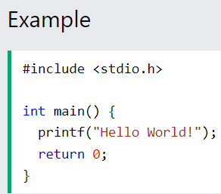
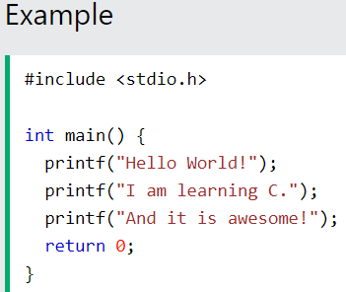
C Output (Print Text)
Output (Print Text)
To output values or print text in C, you can use the printf() function:
You can use as many printf() functions as you want. However, note that it does not insert a new line at the end of the output:
Double Quotes
When you are working with text, it must be wrapped inside double quotations marks "".
If you forget the double quotes, an error occurs.
Output:
Hello World!I am learning C.And it is awesome!
Khandaker Jannatul Ritu, Lecturer(CSE), BAIUST

Slide 19
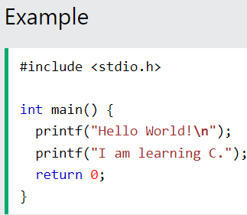
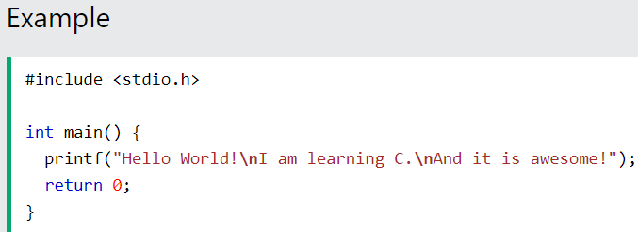
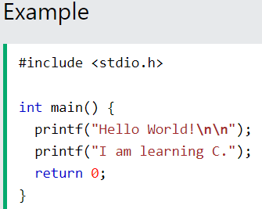
C New Lines
New Lines
To insert a new line, you can use the \n character:
You can also output multiple lines with a single printf() function. However, this could make the code harder to read:
Tip: Two \n characters after each other will create a blank line:
Khandaker Jannatul Ritu, Lecturer(CSE), BAIUST

Slide 20
Escape Sequence in C
The escape sequence in C is the characters or the sequence of characters that can be used inside the string literal. The purpose of the escape sequence is to represent the characters that cannot be used normally using the keyboard. Some escape sequence characters are the part of ASCII charset but some are not.
Escape Sequence | Name | Description
\n | New Line | It moves the cursor to the start of the next line.
\t | Horizontal Tab | It inserts some whitespace to the left of the cursor and moves the cursor accordingly.
\\ | Backlash | Use to insert backslash character.
\’ | Single Quote | It is used to display a single quotation mark.
\” | Double Quote | It is used to display double quotation marks.
\? | Question Mark | It is used to display a question mark.
An escape sequence contains a backslash (\) symbol followed by one of the escape sequence characters or an octal or hexadecimal number.
Khandaker Jannatul Ritu, Lecturer(CSE), BAIUST

Slide 21
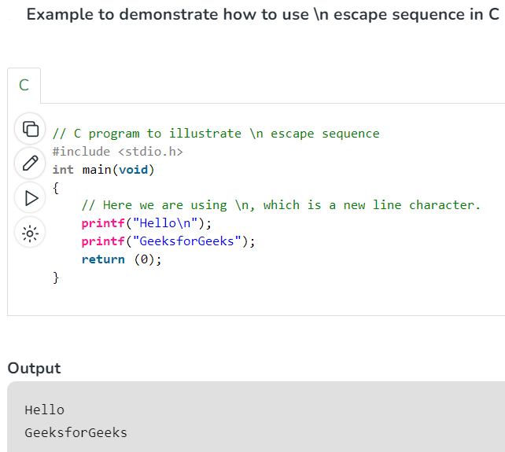
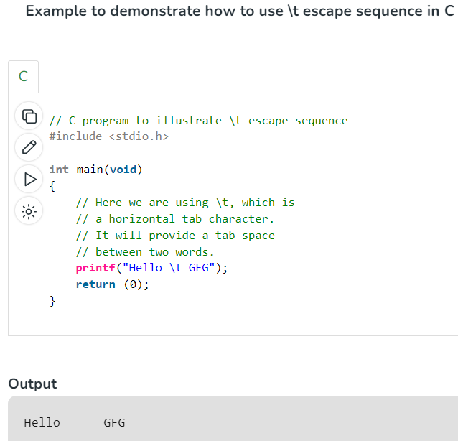
Escape Sequence in C
What is \n exactly?
The newline character (\n) is called an escape sequence, and it forces the cursor to change its position to the beginning of the next line on the screen. This results in a new line.
Khandaker Jannatul Ritu, Lecturer(CSE), BAIUST

Slide 22
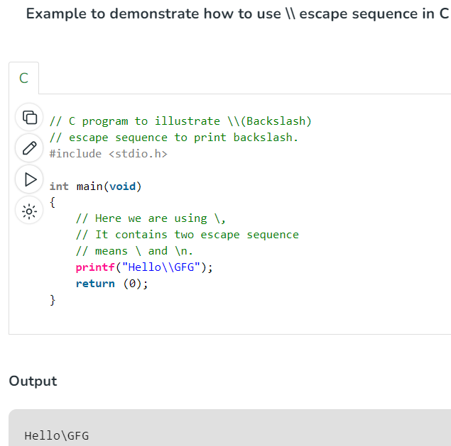
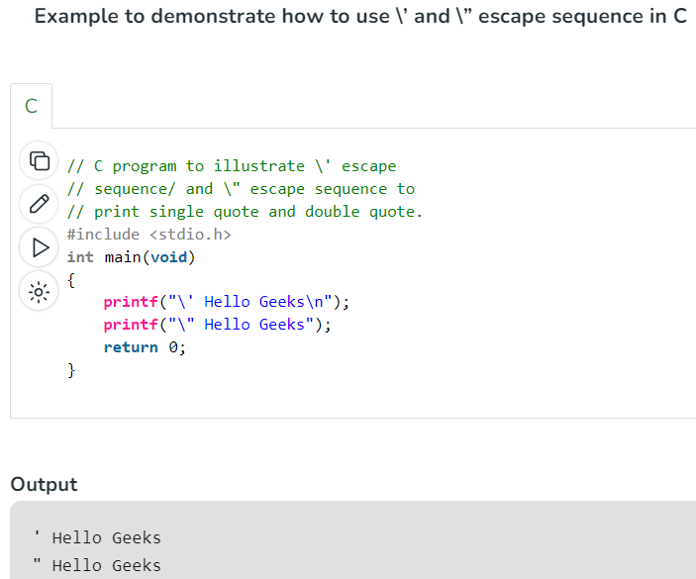
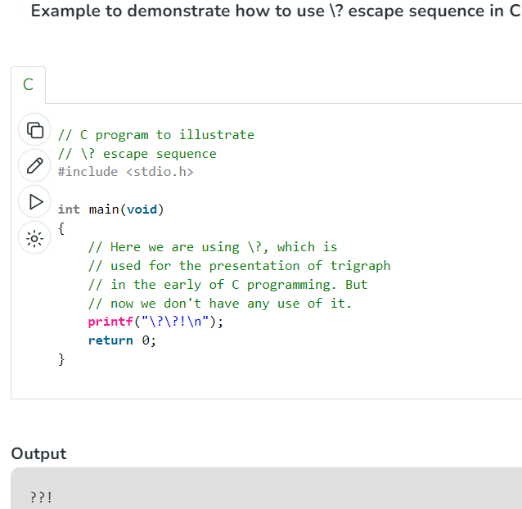
Escape Sequence in C
Khandaker Jannatul Ritu, Lecturer(CSE), BAIUST

Slide 23
Video Resources To Follow(click on the link):-
C programming Bangla Tutorial 5.12 : First C program
C programming Bangla Tutorial 5.13 : Comments and Escape sequence
C programming Bangla Tutorial 5.15 : Keyword, Variable, data type (part-1)
C programming Bangla Tutorial 5.17 : More on data types
Khandaker Jannatul Ritu, Lecturer(CSE), BAIUST

Slide 24
Introduce With Variables, Constants, Literals And Language Processors

Slide 25
Outlines:-
C Variables(Syntax, Components, Rules)
C Variable Types
Explain how Variable is a changeable entity?
How to copy variables?
Add Variables Together
Real-Life Example of variable
Calculate the Area of a Rectangle
Constants in C
Literals
Language Processors: Assembler, Compiler and Interpreter
Khandaker Jannatul Ritu, Lecturer(CSE), BAIUST

Slide 26
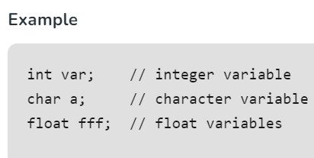
C Variables
Variables are containers for storing data values, like numbers and characters.
In C, there are different types of variables (defined with different keywords), for example:
int - stores integers (whole numbers), without decimals, such as 123 or -123
float/dobule - stores floating point numbers, with decimals, such as 19.99 or -19.99
char - stores single characters, such as 'a' or 'B'. Characters are surrounded by single quotes
A variable in C is a memory location with some name that helps store some form of data and retrieves it when required. We can store different types of data in the variable and reuse the same variable for storing some other data any number of times.
The syntax to declare a variable in C specifies the name and the type of the variable.
Here,
data_type: Type of data that a variable can store.
variable_name: Name of the variable given by the user.
value: value assigned to the variable by the user.
data_type variable_name = value;
or data_type variable_name1, variable_name2;
Khandaker Jannatul Ritu, Lecturer(CSE), BAIUST

Slide 27
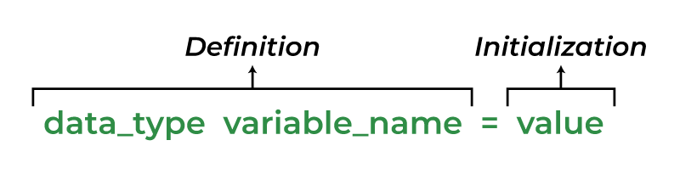
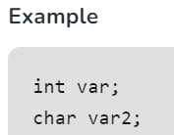
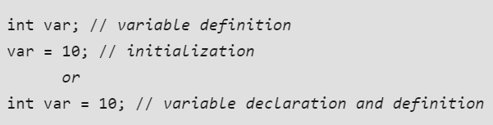
The Three Components Of Declaring A Variable
There are 3 aspects of defining a variable:
1. C Variable Declaration
Variable declaration in C tells the compiler about the existence of the variable with the given name and data type. When the variable is declared compiler automatically allocates the memory for it.
2. C Variable Definition
In the definition of a C variable, the compiler allocates some memory and some value to it. A defined variable will contain some random garbage value till it is not initialized.
3. C Variable Initialization
Initialization of a variable is the process where the user assigns some meaningful value to the variable.
Khandaker Jannatul Ritu, Lecturer(CSE), BAIUST

Slide 28
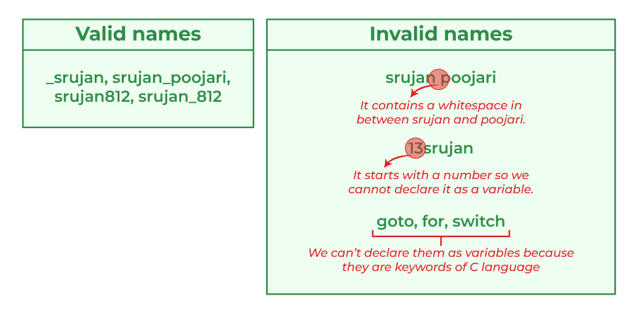
Rules for Naming Variables in C
You can assign any name to the variable as long as it follows the following rules:
Names can contain letters, digits and underscores
Names must begin with a letter or an underscore (_)
Names are case-sensitive (myVar and myvar are different variables)
Names cannot contain whitespaces or special characters like !, #, %, etc.
Reserved words (such as int) cannot be used as names
Khandaker Jannatul Ritu, Lecturer(CSE), BAIUST

Slide 29
C Variable Types
1. Local Variable
A variable that is declared inside the function or block is called a local variable.
It must be declared at the start of the block.
void function1()
{
int x=10;//local variable
}
3. Static Variable
A variable that is declared with the static keyword is called static variable. It retains its value between multiple function calls.
void function1()
{
int x=10;//local variable
static int y=10;//static variable
x=x+1;
y=y+1;
printf("%d,%d",x,y);
}
2. Global Variable
A variable that is declared outside the function or block is called a global variable. Any function can change the value of the global variable. It is available to all the functions.
It must be declared at the start of the block.
int value=20;//global variable
void function1()
{
int x=10;//local variable
}
Khandaker Jannatul Ritu, Lecturer(CSE), BAIUST

Slide 30
4. Automatic Variable
All variables in C that are declared inside the block, are automatic variables by default. We can explicitly declare an automatic variable using auto keyword.
void main()
{
int x=10;//local variable (also automatic)
auto int y=20;//automatic variable
}
6. Register Variables in C
Register variables in C are those variables that are stored in the CPU register instead of the conventional storage place like RAM. Their scope is local and exists till the end of the block or a function.
These variables are declared using the register keyword.
The default value of register variables is a garbage value.
Syntax of Register Variables in C
register data_type variable_name = initial_value;
Register int number = 122;
5. External Variable
We can share a variable in multiple C source files by using an external variable. To declare an external variable, you need to use extern keyword.
myfile.h
extern int x=10;//external variable (also global)
Khandaker Jannatul Ritu, Lecturer(CSE), BAIUST

Slide 31
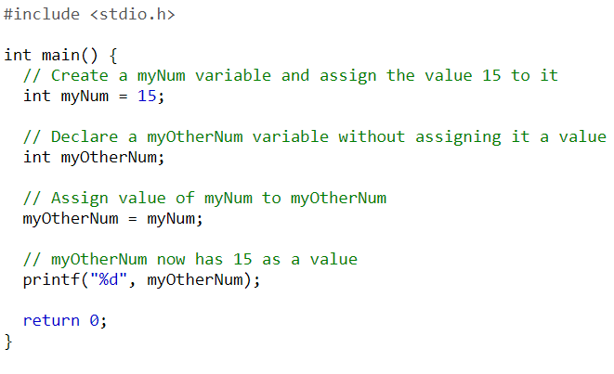
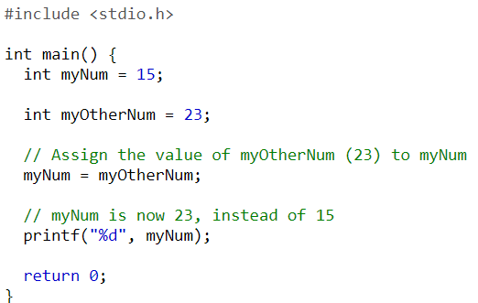
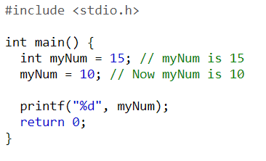
C Variable Values: Copying Variables
int main(){
int id1, id2, id3;
int a,b,c,d;
///type=1
id1 = 5;
id2 = 102;
id3 = id2;
id2 = id1;
id1 = id2;
printf("id1 = %d\n", id1);
printf("id2 = %d\n", id2);
printf("id3 = %d\n\n", id3);
///type=2
a = 61;
a = 23;
printf("a = %d\n\n", a);
a = 78;
a = 32;
printf("a = %d\n\n", a);
}
Change Variable Values. If you assign a new value to an existing variable, it will overwrite the previous value:
Khandaker Jannatul Ritu, Lecturer(CSE), BAIUST

Slide 32
Add Variables Together
#include <stdio.h>
int main() {
int x = 5;
int y = 6;
int sum = x + y;
printf("%d", sum);
return 0;
}
int main(){
int num1, num2;
//printf("Enter two number : ");
//scanf("%d %d", &num1, &num2);
printf("Enter 1st number : ");
scanf("%d", &num1);
printf("Enter 2nd number : ");
scanf("%d", &num2);
int sum;
sum = num1 + num2;\
//printf("\nsum = %d\n", sum);
printf("\n\naddition of ( %d + %d ) = %d\n\n", num1, num2, sum);
}
You can also assign the same value to multiple variables of the same type:
#include <stdio.h>
int main() {
int x, y, z;
x = y = z = 50;
printf("%d", x + y + z);
return 0;
}
Declare Multiple Variables
To declare more than one variable of the same type, use a comma-separated list:
#include <stdio.h>
int main() {
int x = 5, y = 6, z = 50;
printf("%d", x + y + z);
return 0;
}
Khandaker Jannatul Ritu, Lecturer(CSE), BAIUST

Slide 33
Real-life Example
Often in our examples, we simplify variable names to match their data type (myInt or myNum for int types, myChar for char types, and so on). This is done to avoid confusion.
However, if you want a real-life example of how variables can be used, take a look at the following, where we have made a program that stores different data of a college student:
#include <stdio.h>
int main() {
// Student data
int studentID = 15;
int studentAge = 23;
float studentFee = 75.25;
char studentGrade = 'B';
// Print variables
printf("Student id: %d\n", studentID);
printf("Student age: %d\n", studentAge);
printf("Student fee: %f\n", studentFee);
printf("Student grade: %c", studentGrade);
}
Khandaker Jannatul Ritu, Lecturer(CSE), BAIUST

Slide 34
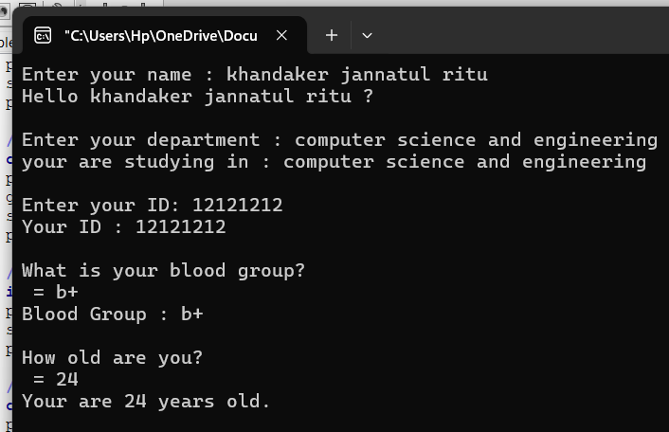
int main()
{
char name[100]; ///-------YOUR NAME--------///
printf("Enter your name : ");
scanf("%[^\n]s", name);
printf("Hello %s \?\n\n", name);
char department[50]; ///--------YOUR DEPARTMENT-------//
printf("Enter your department : ");
getchar();
scanf("%[^\n]s", department);
printf("your are studying in : %s\n\n", department);
int id; ///---- YOUR ID--------///
printf("Enter your ID: ");
scanf("%d", &id);
printf("Your ID : %d\n\n", id);
char blood_group[5]; ///----BLOOD GROUP-----///
printf("What is your blood group?\n = ");
getchar();
scanf("%[^\n]s", &blood_group);
printf("Blood Group : %s\n\n", blood_group);
int age; ///------AGE-----///
printf("How old are you?\n = ");
scanf("%d", &age);
printf("Your are %d years old.\n\n", age);
}
Khandaker Jannatul Ritu, Lecturer(CSE), BAIUST

Slide 35
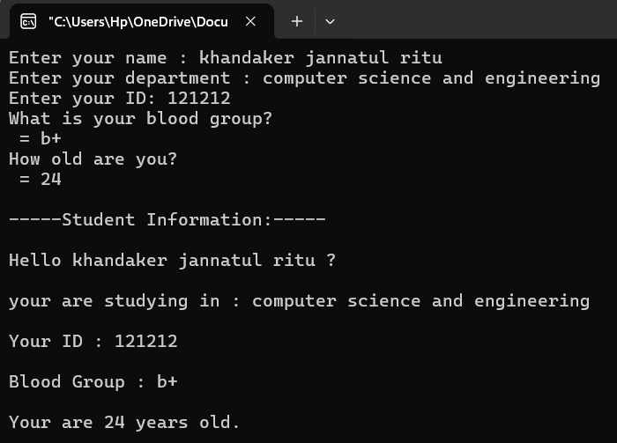
char name[100]; ///-------YOUR NAME--------///
printf("Enter your name : ");
scanf("%[^\n]s", name);
char department[50]; ///--------YOUR DEPARTMENT-------//
printf("Enter your department : ");
getchar();
scanf("%[^\n]s", department);
int id; ///---- YOUR ID--------///
printf("Enter your ID: ");
scanf("%d", &id);
char blood_group[5]; ///----BLOOD GROUP-----///
printf("What is your blood group?\n = ");
getchar();
scanf("%[^\n]s", &blood_group);
int age; ///------AGE-----///
printf("How old are you?\n = ");
scanf("%d", &age);
printf("\n-----Student Information:-----\n\n");
printf("Hello %s \?\n\n", name);//1
printf("your are studying in : %s\n\n", department);//2
printf("Your ID : %d\n\n", id);//3
printf("Blood Group : %s\n\n", blood_group);//4
printf("Your are %d years old.\n\n", age);//5

Slide 36
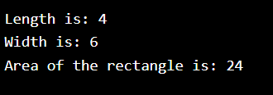
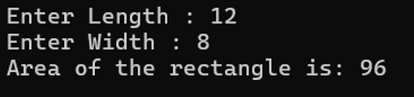
Calculate the Area of a Rectangle (user input)
int main() {
// Create integer variables
int length = 4;
int width = 6;
int area;
// Calculate the area of a rectangle
area = length * width;
// Print the variables
printf("Length is: %d\n", length);
printf("Width is: %d\n", width);
printf("Area of the rectangle is: %d", area);
}
int main() {
// Create integer variables
int length;
int width;
int area;
printf("Enter Length : ");
scanf("%d", & length);
printf("Enter Width : ");
scanf("%d", & width);
// Calculate the area of a rectangle
area = length * width;
// Print the variables
printf("Area of the rectangle is: %d\n\n\n", area);
}
Khandaker Jannatul Ritu, Lecturer(CSE), BAIUST

Slide 37
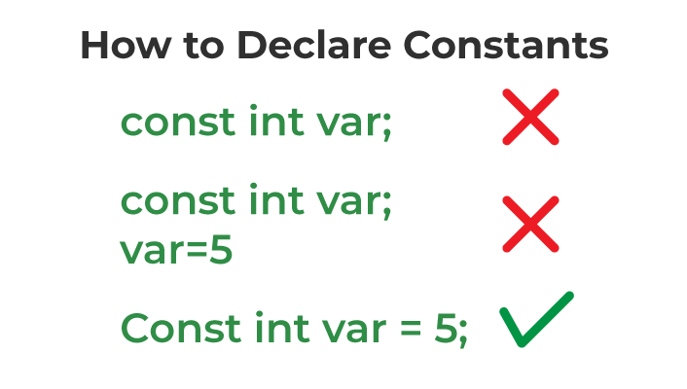
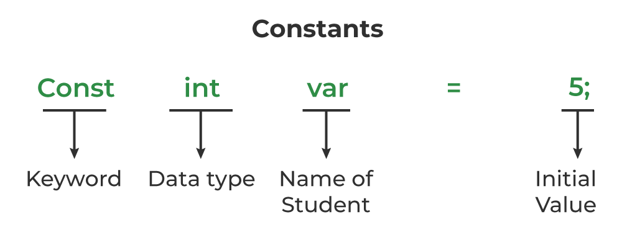
Constants in C : Unchangeable Variable
If you don't want others (or yourself) to change existing variable values, you can use the const keyword.
This will declare the variable as "constant", which means unchangeable and read-only:
How to Define Constant in C?
Properties of Constant in C
The important properties of constant variables in C defined using the const keyword are as follows:
1. Initialization with Declaration
We can only initialize the constant variable in C at the time of its declaration. Otherwise, it will store the garbage value.
2. Immutability
The constant variables in c are immutable after its definition, i.e., they can be initialized only once in the whole program. After that, we cannot modify the value stored inside that variable.
Khandaker Jannatul Ritu, Lecturer(CSE), BAIUST

Slide 38
Constants in C
#include <stdio.h>
int main() {
const int myNum = 15; // myNum will always be 15
myNum = 10; // error: assignment of read-only variable 'myNum'
printf("%d", myNum);
return 0;
}
You should always declare the variable as constant when you have values that are unlikely to change:
#include <stdio.h>
int main() {
const int minutesPerHour = 60;
const float PI = 3.14;
printf("%d\n", minutesPerHour);
printf("%f\n", PI);
return 0;
}
prog.c: In function 'main': prog.c:5:18: error: assignment of read-only variable 'myNum' 5 | myNum = 10; | ^
60 3.140000
Khandaker Jannatul Ritu, Lecturer(CSE), BAIUST

Slide 39
Defining Constant using
#define Preprocessor
We can also define a constant in C using #define preprocessor. The constants defined using #define are macros that behave like a constant. These constants are not handled by the compiler, they are handled by the preprocessor and are replaced by their value before compilation.
#define const_name value
#include<stdio.h>
#define month 12
#define PI 3.1416
const int ar=15;
const float age=25.5;
const double d;
int main(){
const int ar=5;
//ar = 6; // cannot to change
printf("constant variable ar : %d\n\n", ar);
printf("constant variable age : %f\n\n", age);
scanf("%lf", &d);
printf("constant variable d : %lf\n\n", d);
//d =45;// cannot to change
printf("month : %d\n", month);
printf("value of pi : %f\n", PI);
}
Khandaker Jannatul Ritu, Lecturer(CSE), BAIUST

Slide 40
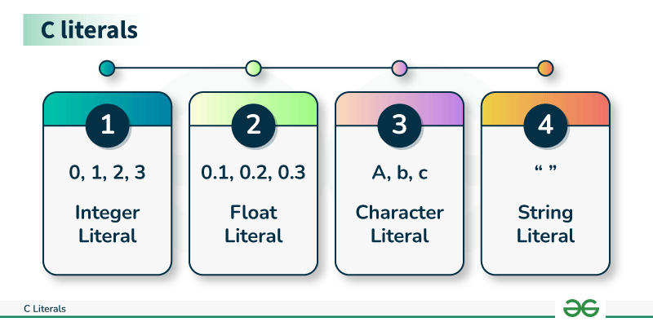
Literals
In C, Literals are the constant values that are assigned to the variables. Literals represent fixed values that cannot be modified. Literals contain memory but they do not have references as variables. Generally, both terms, constants, and literals are used interchangeably. Literals are the constant values assigned to the constant variables. For example, “const int = 5;“, is a constant expression and the value 5 is referred to as a constant integer literal.
Types of C Literals
Integer Literal
Float Literal
Character Literal
String Literal
Khandaker Jannatul Ritu, Lecturer(CSE), BAIUST

Slide 41
#include <stdio.h>
int main()
{
// constant integer literal
const int intVal = 10;
printf("Integer Literal:%d \n", intVal);
return 0;
}
#include <stdio.h>
int main()
{
// constant float literal
const float floatVal = 4.14;
printf("Floating point literal: %.2f\n",floatVal);
return 0;
}
#include <stdio.h>
int main()
{
// constant char literal
const char charVal = 'A';
printf("Character Literal: %c\n",charVal);
return 0;
}
#include <stdio.h>
int main()
{
const char str[]= "Welcome\nTo\nGeeks\tFor\tGeeks";
printf("%s", str);
return 0;
}
Khandaker Jannatul Ritu, Lecturer(CSE), BAIUST

Slide 42
Language Processors: Assembler, Compiler and Interpreter
What is Language Processors?
Compilers, interpreters, translate programs written in high-level languages into machine code that a computer understands and assemblers translate programs written in low-level or assembly language into machine code. In the compilation process, there are several stages. To help programmers write error-free code, tools are available.
1. Compiler
The language processor that reads the complete source program written in high-level language as a whole in one go and translates it into an equivalent program in machine language is called a Compiler. Example: C, C++, C#.
In a compiler, the source code is translated to object code successfully if it is free of errors. The compiler specifies the errors at the end of the compilation with line numbers when there are any errors in the source code. The errors must be removed before the compiler can successfully recompile the source code again the object program can be executed number of times without translating it again.
Khandaker Jannatul Ritu, Lecturer(CSE), BAIUST

Slide 43
2. Assembler
The Assembler is used to translate the program written in Assembly language into machine code. The source program is an input of an assembler that contains assembly language instructions. The output generated by the assembler is the object code or machine code understandable by the computer. Assembler is basically the 1st interface that is able to communicate humans with the machine. We need an assembler to fill the gap between human and machine so that they can communicate with each other. code written in assembly language is some sort of mnemonics(instructions) like ADD, MUL, MUX, SUB, DIV, MOV and so on. and the assembler is basically able to convert these mnemonics in binary code. Here, these mnemonics also depend upon the architecture of the machine.
For example, the architecture of intel 8085 and intel 8086 are different.
Khandaker Jannatul Ritu, Lecturer(CSE), BAIUST

Slide 44
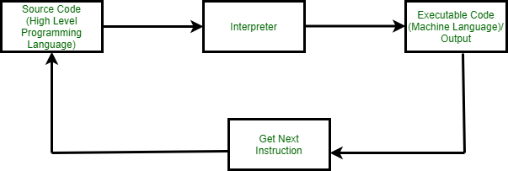
3. Interpreter
The translation of a single statement of the source program into machine code is done by a language processor and executes immediately before moving on to the next line is called an interpreter. If there is an error in the statement, the interpreter terminates its translating process at that statement and displays an error message. The interpreter moves on to the next line for execution only after the removal of the error. An Interpreter directly executes instructions written in a programming or scripting language without previously converting them to an object code or machine code. An interpreter translates one line at a time and then executes it.
Example: Perl, Python and Matlab.
Khandaker Jannatul Ritu, Lecturer(CSE), BAIUST

Slide 45
Video Resources
C programming Bangla Tutorial 5.4 : Translator program - Compiler,Interpreter
C programming Bangla Tutorial 5.15 : Keyword, Variable, data type (part-1)
C programming Bangla Tutorial 5.16 : Keyword, Variable, data type (part-2)
C programming Bangla Tutorial 5.17 : More on data types
C programming Bangla Tutorial 5.18 : how to get user input using scanf
C programming Bangla Tutorial 5.19 : Get inputs using gets, fgets, getchar
Khandaker Jannatul Ritu, Lecturer(CSE), BAIUST

Slide 47
Data Types In ‘C’
Data Types In ‘C’
Data Types In ‘C’
Data Types In ‘C’
Course Title :- Structured Programming Language Sessional
Course Code :- CSE-122
Level Term: 1-II-A(G1) & 1-II-B(G3,G4)
Khandaker Jannatul Ritu, Lecturer(CSE), BAIUST

Slide 48
Topics in Data types
Data types
primitive data type
derived data type
user defined data type
Basic format specifiers
The sizeof() operator
Character Data types
Integer Data types
Float Data types
Double Data types
Boolean in C
Type conversion in C
implicit type conversion
explicit type conversion
Khandaker Jannatul Ritu, Lecturer(CSE), BAIUST

Slide 49
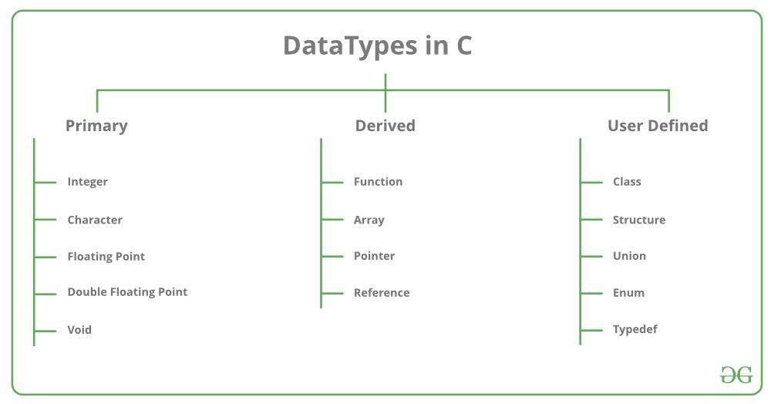
Data Types
Khandaker Jannatul Ritu, Lecturer(CSE), BAIUST

Slide 50
Data Type | Size (bytes) | Range | Format Specifier
short int | 2 | -32,768 to 32,767 | %hd
unsigned short int | 2 | 0 to 65,535 | %hu
unsigned int | 4 | 0 to 4,294,967,295 | %u
int | 4 | -2,147,483,648 to 2,147,483,647 | %d
long int | 4 | -2,147,483,648 to 2,147,483,647 | %ld
unsigned long int | 4 | 0 to 4,294,967,295 | %lu
long long int | 8 | -(2^63) to (2^63)-1 | %lld
unsigned long long int | 8 | 0 to 18,446,744,073,709,551,615 | %llu
signed char | 1 | -128 to 127 | %c
unsigned char | 1 | 0 to 255 | %c
float | 4 | 1.2E-38 to 3.4E+38 | %f
double | 8 | 1.7E-308 to 1.7E+308 | %lf
long double | 16 | 3.4E-4932 to 1.1E+4932 | %Lf
Khandaker Jannatul Ritu, Lecturer(CSE), BAIUST

Slide 51
Size of Data Types in C
#include<stdio.h>
int main()
{
int i;
float f;
double d;
char c;
char ch[100];
printf("size of int = %d bytes\n", sizeof(i));
printf("size of int = %d bytes\n", sizeof(f));
printf("size of int = %d bytes\n", sizeof(d));
printf("size of int = %d bytes\n", sizeof(c));
printf("size of int = %d bytes\n", sizeof(ch));
}
Output:
size of int = 4 bytes
size of int = 4 bytes
size of int = 8 bytes
size of int = 1 bytes
size of int = 100 bytes
Khandaker Jannatul Ritu, Lecturer(CSE), BAIUST

Slide 52
Integer Data Type
The integer datatype in C is used to store the integer numbers(any number including positive, negative and zero without decimal part). Octal values, hexadecimal values, and decimal values can be stored in int data type in C.
Range: -2,147,483,648 to 2,147,483,647
Size: 4 bytes
Format Specifier: %d
#include <stdio.h>
int main() {
int myNum = 1000;
printf("%d", myNum);
}
Syntax of Integer
int var_name;
Integer size 4bytes
1 byte = 8bit
4 byte = 8 * 4 bit = 32bit
If n=3
Memory will be store it as:- 00000000 00000000 00000000 00000011
1st byte
2nd byte
3rd byte
4th byte
Khandaker Jannatul Ritu, Lecturer(CSE), BAIUST

Slide 53
Character Data Type
Character data type allows its variable to store only a single character. The size of the character is 1 byte.
It is the most basic data type in C. It stores a single character and requires a single byte of memory in almost all compilers.
Range: (-128 to 127) or (0 to 255)
Size: 1 byte
Format Specifier: %c
Syntax of char
The char keyword is used to declare the variable of character type:
char var_name;
Khandaker Jannatul Ritu, Lecturer(CSE), BAIUST

Slide 54
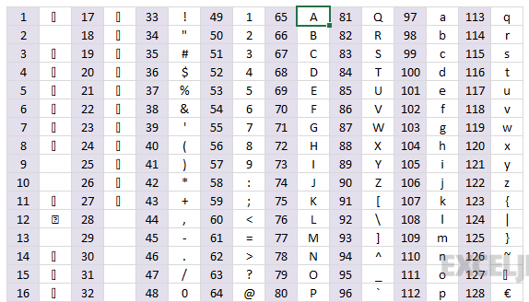

Slide 55
Character → ASCII → Character
#include<stdio.h>
int main(){
/// character --> ascii value
char ch;
printf(" Enter a ascii characters: ");
scanf("%c", &ch);
printf(" corresponding value : %d\n\n", ch);
///ascii value --> character
int a;
printf(" Enter a value: ");
scanf("%d", &a);
printf(" corresponding ascii character : %c\n", a);
}
Lowercase → Uppercase → Lowercase
#include<stdio.h>
int main(){
///lower to upper
char lower;
printf("Enter a letter between (a-z): ");
scanf("%c", &lower);
printf("uppercase method-1 : %c\n", (lower - 32));
printf("uppercase method-2 : %c\n\n", toupper(lower));
getchar();
///lower to upper
char upper;
printf("Enter a letter between (A-Z): ");
scanf("%c", &upper);
printf("uppercase method-1 : %c\n", (upper + 32));
printf("uppercase method-2 : %c\n\n", tolower(upper));
}
Enter a ascii characters: T
corresponding value : 84
Enter a value: 83
corresponding ascii character : S
Enter a letter between (a-z): a
uppercase method-1 : A
uppercase method-2 : A
Enter a letter between (A-Z): R
uppercase method-1 : r
uppercase method-2 : r

Slide 56
Float Data Type
In C programming float data type is used to store floating-point values. Float in C is used to store decimal and exponential values. It is used to store decimal numbers (numbers with floating point values) with single precision.
Range: 1.2E-38 to 3.4E+38
Size: 4 bytes
Format Specifier: %f
Syntax of float
The float keyword is used to declare the variable as a floating point:
float var_name;
#include <stdio.h>
int main()
{
float a = 9.0;
printf("%f\n", a);
}
Output
9.000000
Khandaker Jannatul Ritu, Lecturer(CSE), BAIUST

Slide 57
Double Data Type
A Double data type in C is used to store decimal numbers (numbers with floating point values) with double precision. It is used to define numeric values which hold numbers with decimal values in C.
The double data type is basically a precision sort of data type that is capable of holding 64 bits of decimal numbers or floating points. Since double has more precision as compared to that float then it is much more obvious that it occupies twice the memory occupied by the floating-point type. It can easily accommodate about 16 to 17 digits after or before a decimal point.
Range: 1.7E-308 to 1.7E+308
Size: 8 bytes
Format Specifier: %lf
#include <stdio.h>
int main()
{
double b = 12.293123;
printf("%lf\n", b);
}
Syntax of Double
The variable can be declared as double precision floating point using the double keyword:
double var_name;
Output
12.293123
Khandaker Jannatul Ritu, Lecturer(CSE), BAIUST

Slide 58
Double Data Type
float vs. double
The precision of a floating point value indicates how many digits the value can have after the decimal point. The precision of float is six or seven decimal digits, while double variables have a precision of about 15 digits. Therefore, it is often safer to use double for most calculations - but note that it takes up twice as much memory as float (8 bytes vs. 4 bytes).
Scientific Numbers
A floating point number can also be a scientific number with an "e" to indicate the power of 10:
#include <stdio.h>
int main()
{
float f1 = 35e3;
printf("%f\n", f1);
}
Output:
35000
Khandaker Jannatul Ritu, Lecturer(CSE), BAIUST

Slide 59
C Decimal Precision
If you want to remove the extra zeros (set decimal precision), you can use a dot (.) followed by a number that specifies how many digits that should be shown after the decimal point:
#include <stdio.h>
int main()
{
float myFloatNum = 3.5;
printf("%f\n", myFloatNum); // Default will show 6 digits after the decimal point
printf("%.1f\n", myFloatNum); // Only show 1 digit
printf("%.2f\n", myFloatNum); // Only show 2 digits
printf("%.4f", myFloatNum); // Only show 4 digits
}
Khandaker Jannatul Ritu, Lecturer(CSE), BAIUST

Slide 60
Boolean in C
C Boolean
In C, Boolean is a data type that contains two types of values, i.e., 0 and 1. Basically, the bool type value represents two types of behavior, either true or false. Here, '0' represents false value, while '1' represents true value.
In C Boolean, '0' is stored as 0, and another integer is stored as 1. We do not require to use any header file to use the Boolean data type in C++, but in C, we have to use the header file, i.e., stdbool.h. If we do not use the header file, then the program will not compile.
Syntax
bool variable_name;
Booleans
Very often, in programming, you will need a data type that can only have one of two values, like:
YES / NO
ON / OFF
TRUE / FALSE
For this, C has a bool data type, which is known as booleans.
Booleans represent values that are either true or false.
Khandaker Jannatul Ritu, Lecturer(CSE), BAIUST

Slide 61
Boolean in C
Therefore, you must use the %d format specifier to print a boolean value:
#include <stdio.h>
#include <stdbool.h> // Import the boolean header file
int main()
{
bool isProgrammingFun = true;
bool isFishTasty = false;
printf("%d\n", isProgrammingFun); // Returns 1 (true)
printf("%d", isFishTasty); // Returns 0 (false)
}
Output:
1
0
Khandaker Jannatul Ritu, Lecturer(CSE), BAIUST

Slide 62
Comparing Values and Variables
Comparing values are useful in programming, because it helps us to find answers and make decisions.
For example, you can use a comparison operator, such as the greater than (>) operator, to compare two values:
#include <stdio.h>
int main()
{
printf("%d", 10 > 9);
// Returns 1 (true) because 10 is greater than 9
}
Output:
1
#include <stdio.h>
int main() {
int x = 10;
int y = 9;
printf("%d", x > y);
// Returns 1 (true) because 10 is greater than 9
}
Output:
1
Khandaker Jannatul Ritu, Lecturer(CSE), BAIUST

Slide 63
Comparing Values and Variables
In the example below, we use the equal to (==) operator to compare different values:
#include <stdio.h>
int main() {
printf("%d\n", 10 == 10); // Returns 1 (true), because 10 is equal to 10
printf("%d\n", 10 == 15); // Returns 0 (false), because 10 is not equal to 15
printf("%d", 5 == 55); // Returns 0 (false) because 5 is not equal to 55
}
Output:
1
0
0
#include <stdio.h>
#include <stdbool.h>
int main() {
bool isHamburgerTasty = true;
bool isPizzaTasty = true;
printf("%d", isHamburgerTasty == isPizzaTasty);
}
Output: 1
Khandaker Jannatul Ritu, Lecturer(CSE), BAIUST

Slide 64
Comparing Values and Variables :- Real Life Example
Let's think of a "real life example" where we need to find out if a person is old enough to vote.
In the example below, we use the >= comparison operator to find out if the age (25) is greater than OR equal to the voting age limit, which is set to 18:
#include <stdio.h>
int main()
{
int myAge = 25;
int votingAge = 18;
printf("%d", myAge >= votingAge); // Returns 1 (true), meaning 25 year olds are allowed to vote!
}
Output:
1
Khandaker Jannatul Ritu, Lecturer(CSE), BAIUST

Slide 65
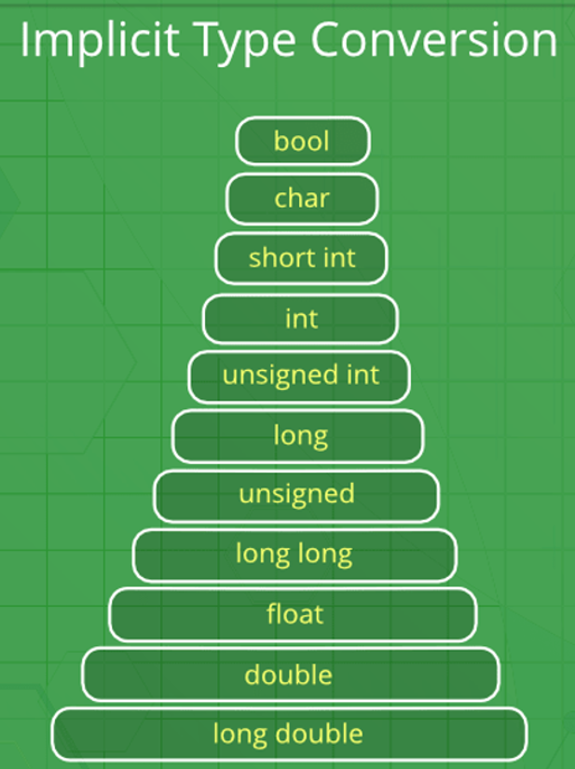
Type Conversion in C
Type conversion in C is the process of converting one data type to another. The type conversion is only performed to those data types where conversion is possible. Type conversion is performed by a compiler. In type conversion, the destination data type can’t be smaller than the source data type. Type conversion is done at compile time and it is also called widening conversion because the destination data type can’t be smaller than the source data type. There are two types of Conversion:
1. Implicit Type Conversion
Also known as ‘automatic type conversion’.
A. Done by the compiler on its own, without any external trigger from the user.
B. Generally takes place when in an expression more than one data type is present. In such conditions type conversion (type promotion) takes place to avoid loss of data.
C. All the data types of the variables are upgraded to the data type of the variable with the largest data type.
D. It is possible for implicit conversions to lose information, signs can be lost (when signed is implicitly converted to unsigned), and overflow can occur (when long is implicitly converted to float).
bool → char → int → long long → float → double → long double
Khandaker Jannatul Ritu, Lecturer(CSE), BAIUST

Slide 66
Sometimes, you have to convert the value of one data type to another type. This is known as type conversion.
For example, if you try to divide two integers, 5 by 2, you would expect the result to be 2.5. But since we are working with integers (and not floating-point values), the following example will just output 2:
#include <stdio.h>
int main() {
int x = 5;
int y = 2;
int sum = 5 / 2;
printf("%d", sum);
return 0;
}
output: 2
Implicit conversion is done automatically by the compiler when you assign a value of one type to another.
For example, if you assign an int value to a float type:
Example
// Automatic conversion: int to float
float myFloat = 9;
printf("%f", myFloat); // 9.000000
As you can see, the compiler automatically converts the int value 9 to a float value of 9.000000.
This can be risky, as you might lose control over specific values in certain situations.
Khandaker Jannatul Ritu, Lecturer(CSE), BAIUST

Slide 67
Example of Type Implicit Conversion
// An example of implicit conversion
#include <stdio.h>
int main()
{
int x = 10; // integer x
char y = 'a'; // character c
// y implicitly converted to int. ASCII
// value of 'a' is 97
x = x + y;
// x is implicitly converted to float
float z = x + 1.0;
printf("x = %d, z = %f", x, z);
}
Especially if it was the other way around - the following example automatically converts the float value 9.99 to an int value of 9:
Example
// Automatic conversion: float to int
int myInt = 9.99;
printf("%d", myInt); // 9
What happened to .99? We might want that data in our program! So be careful. It is important that you know how the compiler work in these situations, to avoid unexpected results.
Output
x = 107, z = 108.000000
Khandaker Jannatul Ritu, Lecturer(CSE), BAIUST

Slide 68
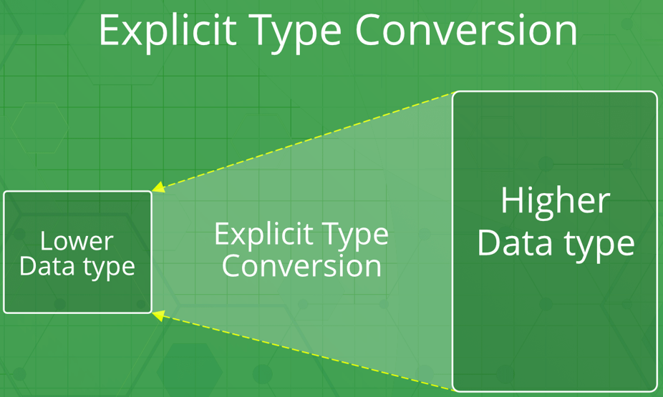
2. Explicit Type Conversion
This process is also called type casting and it is user-defined. Here the user can typecast the result to make it of a particular data type.
The syntax in C Programming:
(type) expression
Type indicated the data type to which the final result is converted.
Explicit conversion is done manually by placing the type in parentheses () in front of the value.
Considering our problem from the example above, we can now get the right result:
Example
// Manual conversion: int to float
float sum = (float) 5 / 2;
printf("%f", sum); // 2.500000
Khandaker Jannatul Ritu, Lecturer(CSE), BAIUST

Slide 69
// C program to demonstrate explicit type casting
#include<stdio.h>
int main()
{
double x = 1.2;
// Explicit conversion from double to int
int sum = (int)x + 1;
printf("sum = %d", sum);
return 0;
}
Output
sum = 2
You can also place the type in front of a variable:
int num1 = 5;
int num2 = 2;
float sum = (float) num1 / num2;
printf("%f", sum); // 2.500000
And since you learned about "decimal precision" in the previous chapter, you could make the output even cleaner by removing the extra zeros (if you like):
int num1 = 5;
int num2 = 2;
float sum = (float) num1 / num2;
printf("%.1f", sum); // 2.5
Khandaker Jannatul Ritu, Lecturer(CSE), BAIUST

Slide 70
Advantages of Type Conversion
Type safety:
Improved code readability:
Improved performance:
Improved compatibility
Improved data manipulation
Improved data storage
Disadvantages of type conversions in C programming:
Loss of precision: Converting data from a larger data type to a smaller data type can result in loss of precision, as some of the data may be truncated.
Overflow or underflow: Converting data from a smaller data type to a larger data type can result in overflow or underflow if the value being converted is too large or too small for the new data type.
Unexpected behavior: Type conversions can lead to unexpected behavior, such as when converting between signed and unsigned integer types, or when converting between floating-point and integer types.
Confusing syntax: Type conversions can have confusing syntax, particularly when using typecast operators or type conversion functions, making the code more difficult to read and understand.
Increased complexity: Type conversions can increase the complexity of your code, making it harder to debug and maintain.
Slower performance: Type conversions can sometimes result in slower performance, particularly when converting data between complex data types, such as between structures and arrays.
Khandaker Jannatul Ritu, Lecturer(CSE), BAIUST

Slide 71
Real-life Example Of Using Different Data Types
Here's a real-life example of using different data types, to calculate and output the total cost of a number of items:
#include <stdio.h>
int main() {
// Create variables of different data types
int items = 50;
float cost_per_item = 9.99;
float total_cost = items * cost_per_item;
char currency = '$';
// Print variables
printf("Number of items: %d\n", items);
printf("Cost per item: %.2f %c\n", cost_per_item, currency);
printf("Total cost = %.2f %c\n", total_cost, currency);
}
Khandaker Jannatul Ritu, Lecturer(CSE), BAIUST

Slide 72
Real-Life Example of type conversion
Here's a real-life example of data types and type conversion where we create a program to calculate the percentage of a user's score in relation to the maximum score in a game:
#include <stdio.h>
int main() {
// Set the maximum possible score to 500
int maxScore = 500;
// The actual score of the user
int userScore = 420;
// Calculate the percantage of the user's score in relation to the maximum available score
float percentage = (float) userScore / maxScore * 100.0;
// Print the percentage
printf("User's percentage is %.2f", percentage);
}
Output:
User's percentage is 84.00
Khandaker Jannatul Ritu, Lecturer(CSE), BAIUST

Slide 74
C Input/Output
C Input/Output
C Input/Output
C Input/Output
Course Title :- Structured Programming Language Sessional
Course Code :- CSE-122
Level Term: 1-II-A(G1) & 1-II-B(G3,G4)
Khandaker Jannatul Ritu, Lecturer(CSE), BAIUST

Slide 75
Topics
Basic Input and Output in C
Format Specifiers in C
printf() in C
scanf() in C
Formatted and Unformatted Input/Output functions in C with Examples
Khandaker Jannatul Ritu, Lecturer(CSE), BAIUST

Slide 76
Basic Input and Output in C
scanf()
The scanf() method, in C, reads the value from the console as per the type specified and store it in the given address.
Syntax:
scanf("%X", &variableOfXType);
where %X is the format specifier in C. It is a way to tell the compiler what type of data is in a variable and & is the address operator in C, which tells the compiler to change the real value of variableOfXType, stored at this address in the memory.
printf()
The printf() method, in C, prints the value passed as the parameter to it, on the console screen.
Syntax:
printf("%X", variableOfXType);
where %X is the format specifier in C. It is a way to tell the compiler what type of data is in a variable and variableOfXType is the variable to be printed.
Khandaker Jannatul Ritu, Lecturer(CSE), BAIUST

Slide 77
How To Take Input And Output Of Basic Types In C?
The basic type in C includes types like int, float, char, etc. Inorder to input or output the specific type, the X in the above syntax is changed with the specific format specifier of that type. The Syntax for input and output for these are:
Integer:
Input: scanf("%d", &intVariable);
Output: printf("%d", intVariable);
Float:
Input: scanf("%f", &floatVariable);
Output: printf("%f", floatVariable);
Double:
Input: scanf("%lf", &doubleVariable);
Output: printf("%lf", doubleVariable);
Character:
Input: scanf("%c", &charVariable);
Output: printf("%c", charVariable);
String word:
Input: scanf("%s", &stringVariable);
Output: printf("%s", stringVariable);
String sentence
Input: scanf("%[^\n]s", &stringVariable);
Output: printf("%s", stringVariable);
Khandaker Jannatul Ritu, Lecturer(CSE), BAIUST

Slide 78
int main()
{
int num; float f; double d;
printf("Enter the integer: ");
scanf("%d", &num);
printf("\nEntered integer is: %d", num);
printf("\n\nEnter the float: ");
scanf("%f", &f);
printf("\nEntered float is: %f", f);
printf("\n\nEnter the double: ");
scanf("%lf", &d);
printf("\nEntered float is: %lf", d);
}
Enter the integer: 45
Entered integer is: 45
Enter the float: 4.5
Entered float is: 4.500000
Enter the double: 4.03
Entered float is: 4.030000
Khandaker Jannatul Ritu, Lecturer(CSE), BAIUST

Slide 79
// C program to show input and output
#include <stdio.h>
int main()
{
char ch;
// Input the Character
printf("\nEnter the Character: ");
scanf("%c", &ch);
// Output the Character
printf("\nEntered character is: %c\n\n", ch);
return 0;
}
// C program to show input and output
#include <stdio.h>
int main()
{
char str[50];
// --- String ---To read a word
// Input the Word
printf("Enter the Word: ");
scanf("%s\n", str);
// Output the Word
printf("\nEntered Word is: %s", str);
return 0;
}
Enter the Character: ritu
Entered character is: r
Enter the Word: computer science
Entered Word is: computer
Khandaker Jannatul Ritu, Lecturer(CSE), BAIUST

Slide 80
// C program to show input and output
#include <stdio.h>
int main()
{
char str[50];
// --- String ---To read a Sentence
// Input the Sentence
printf("\nEnter the Sentence: ");
scanf("%[^\n]s", str);
// Output the String
printf("\nEntered Sentence is: %s\n\n", str);
return 0;
}
Enter the Sentence: we are learning c-programming language
Entered Sentence is: we are learning c-programming language
Khandaker Jannatul Ritu, Lecturer(CSE), BAIUST

Slide 81
Format Specifiers in C
Format Specifier | Description
%c | For character type.
%d | For signed integer type.
%f | For float type.
%ld or %li | Long
%lf | Double
%Lf | Long double
%lli or %lld | Long long
%o | Octal representation
%p | Pointer
%s | String
%u | Unsigned int
%x or %X | Hexadecimal representation
%n | Prints nothing
%% | Prints % character
Khandaker Jannatul Ritu, Lecturer(CSE), BAIUST

Slide 82
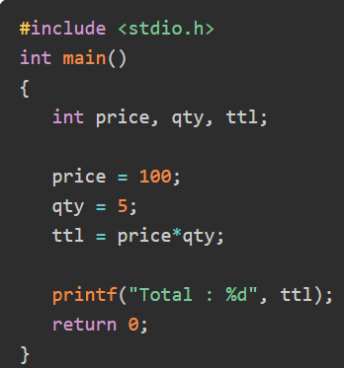
Need for User Input in C
Every computer application accepts certain data from the user, performs a predefined process on the same to produce the output. There are no keywords in C that can read user inputs. The standard library that is bundled with the C compiler includes stdio.h header file, whose library function scanf() is most commonly used to accept user input from the standard input stream. In addition, the stdio.h library also provides other functions for accepting input.
To understand the need for user input, consider the following C program −
Khandaker Jannatul Ritu, Lecturer(CSE), BAIUST

Slide 83
Integer Input
The %d format specifier has been defined for signed integer. The following program reads the user input and stores it in the int variable num.
Example: Integer Input in C
Example: Multiple Integer Inputs in C
#include <stdio.h>
int main()
{
int num1, num2;
printf("Enter two integers: ");
scanf("%d %d", &num1, &num2);
printf("You entered two integers : %d and %d", num1, num2);
return 0;
}
Output
Enter two integers: 45 57
You entered two integers : 45 and 57
#include <stdio.h>
int main()
{
int num;
printf("Enter an integer: ");
scanf("%d", &num);
printf("You entered an integer : %d", num);
return 0;
}
Enter an integer: 234
You entered an integer : 234
Khandaker Jannatul Ritu, Lecturer(CSE), BAIUST

Slide 84
Float Input:- For floating point input, you need to use %f format specifier.
Example: Float Input in C
int main(){
float num1;
printf("Enter a number: ");
scanf("%f", &num1);
printf("You entered a floating-point number: %f", num1);
}
Output
Enter a number: 34.56
You entered a floating-point number: 34.560001
Example: Integer and Float Inputs in C
int main(){
int num1;
float num2;
printf("Enter two numbers: ");
scanf("%d %f", &num1, &num2);
printf("You entered an integer: %d a floating-point number: %6.2f", num1, num2);
}
Output
Enter two numbers: 65 34.5678
You entered an integer: 65 a floating-point number: 34.57
Khandaker Jannatul Ritu, Lecturer(CSE), BAIUST

Slide 85
Character Input
The %c format specifier reads a single character from the keyboard. However, we must give a blank space before %c in the format string. This is because the %c conversion specifier won't automatically skip any leading whitespace, so if there's a stray newline in the input stream (from a previous entry, for example) the scanf() call will consume it immediately.
scanf(" %c", &c);
The blank in the format string tells scanf to skip leading whitespace, and the first non-whitespace character will be read with the %c conversion specifier.
Example: Character Input in C
#include <stdio.h>
int main(){
char ch;
printf("enter a single character: ");
scanf(" %c", &ch);
printf("You entered character : %c", ch);
}
Output
enter a single character: x
You entered character : x
Khandaker Jannatul Ritu, Lecturer(CSE), BAIUST

Slide 86
Example: Multiple Character Inputs in C
The following program reads two characters separated by a space in two char variables.
int main(){
char ch1, ch2;
printf("enter a two characters: ");
scanf("%c %c", &ch1, &ch2);
printf("You entered characters : %c and %c", ch1, ch2);
return 0;
}
Output
enter a two characters: x y
You entered characters : x and y
Khandaker Jannatul Ritu, Lecturer(CSE), BAIUST

Slide 87
Example: Character Input Using gets()
#include <stdio.h>
int main()
{
char ch;
printf("enter a character: ");
ch = getchar();
puts("You entered: ");
putchar(ch);
printf("\nYou entered character : %c", ch);
return 0;
}
Output
enter a character: W
You entered:
W
You entered character : W
You can also use the unformatted putchar() function to print a single character.
Khandaker Jannatul Ritu, Lecturer(CSE), BAIUST

Slide 88
String Input
There is also a %s format specifier that reads a series of characters into a char array.
Example: String Input Using scanf()
The following program accepts the string input from the keyboard −
#include <stdio.h>
int main()
{
char name[20];
printf("Enter your name: ");
scanf("%s", name);
printf("You entered the name : %s", name);
}
Output
Enter your name: Ravikant
You entered the name : Ravikant

Slide 89
Example: String Input Using gets()
#include <stdio.h>
int main()
{
char name[20];
printf("Enter your name: ");
gets(name);
printf("You entered the name : %s", name);
return 0;
}
Output
Enter your name: Ravikant Soni
You entered the name : Ravikant Soni

Slide 90
Formatted and Unformatted Input/Output functions in C with Examples
Formatted I/O Functions
Formatted I/O functions are used to take various inputs from the user and display multiple outputs to the user. These types of I/O functions can help to display the output to the user in different formats using the format specifiers. These I/O supports all data types like int, float, char, and many more.
Why they are called formatted I/O? These functions are called formatted I/O functions because we can use format specifiers in these functions and hence, we can format these functions according to our needs.
The following formatted I/O functions will be discussed in this section-
printf()
scanf()
sprintf()
sscanf()
int main()
{
int num1;
// Printing a message on
// the output screen
printf("Enter a integer number: ");
// Taking an integer value
// from keyboard
scanf("%d", &num1);
// Displaying the entered value
printf("You have entered %d", num1);
}
Khandaker Jannatul Ritu, Lecturer(CSE), BAIUST

Slide 91
Unformatted Input/Output functions
Unformatted I/O functions are used only for character data type or character array/string and cannot be used for any other datatype. These functions are used to read single input from the user at the console and it allows to display the value at the console.
Why they are called unformatted I/O?
These functions are called unformatted I/O functions because we cannot use format specifiers in these functions and hence, cannot format these functions according to our needs.
The following unformatted I/O functions will be discussed in this section-
getch()
getche()
getchar()
putchar()
gets()
puts()
putch()
#include <conio.h>
#include <stdio.h>
int main()
{
char name[50];
puts("Please enter some texts: ");
gets(name);
puts(name);
getch();
}
Khandaker Jannatul Ritu, Lecturer(CSE), BAIUST

Slide 92
Formatted I/O vs Unformatted I/O
S No. | Formatted I/O functions | Unformatted I/O functions
1 | These functions allow us to take input or display output in the user’s desired format. | These functions do not allow to take input or display output in user desired format.
2 | These functions support format specifiers. | These functions do not support format specifiers.
3 | These are used for storing data more user friendly | These functions are not more user-friendly.
4 | Here, we can use all data types. | Here, we can use only character and string data types.
5 | printf(), scanf, sprintf() and sscanf() are examples of these functions. | getch(), getche(), gets() and puts(), are some examples of these functions.
Khandaker Jannatul Ritu, Lecturer(CSE), BAIUST

Slide 93
Program-1:- Find summation and average of 3 number
/*
sum = a+b+c
avg = (a+b+c) / 3
*/
Program-2:- Find area of rectangle, triangle, circle, square
/*
area of rectangle: h * w
area of triangle:(1/2) * b * h
area of circle pi * r * r
area of square: a * a
*/
Program-3:- Convert F to C and C to F
///Fahrenheit to Celsius : C = (F - 32) × 5/9
///Celsius to Fahrenheit : F = ((9×C)/ 5) + 32
Khandaker Jannatul Ritu, Lecturer(CSE), BAIUST

